Slide 1


Serialization in C++ has never been easier! But wait, there's more...
Pavel Novikov
@cpp_ape
Align Technology R&D

Slide 2

We’ll talk about
Reflection
Metaprogramming
It’s not in C++ 20
maybe will be in C++ 23
probably will be in C++ 26
mere mortals will be able to use it in 2027 … probably…
everything can change entirely…

Slide 3


It’s

Slide 4
namespace meta = std::experimental::meta;
template<typename Visitor, typename T>
void iterateMembers(Visitor &&visit, T &&value) {
using Type = std::decay_t<T>;
consteval {
for (auto m : meta::data_member_range(reflexpr(Type)))
-> fragment {
requires Visitor &&visit;
requires T &&value;
visit(value.idexpr(%{ m }), meta::name_of(%{ m }));
};
}
}

Slide 5

Serialization (without fatal flaw)
Review in 5 minutes

Slide 6

Serialization (without fatal flaw)
serialize(std::cout, Foo{});
struct Foo {
std::optional<int> empty;
int number = 42;
std::string string = "bleh!";
std::vector<int> array = {
1,
2,
3
};
struct {
std::string iAm = "nested!";
} nestedStruct;
struct {} emptyStruct;
};
{
"empty": null,
"number": 42,
"string": "bleh!",
"array": [
1,
2,
3
],
"nestedStruct": {
"iAm": "nested!"
},
"emptyStruct": {}
}

Slide 7
Serialization (without fatal flaw)
struct SerializationHelper {
//...
template<typename T>
void printValue(const std::vector<T> &vector, size_t indent);
template<typename T>
void printValue(const std::optional<T> &value, size_t indent);
template<typename T>
void printValue(const T &value, size_t indent);
template<typename T>
static void iterateMembersHelper(std::ostream &stream, const T &value, size_t indent);
};
template<typename T>
void serialize(std::ostream &stream, const T &value) {
SerializationHelper{ stream }.printValue(value, /*indent*/ 0);
}

Slide 8
Serialization (without fatal flaw)
int number = 42;
serialize(std::cout, number);
std::string string = "#cpponsea";
serialize(std::cout, string);
std::vector<std::string> array = {
"one",
"two",
"three"
};
serialize(std::cout, array);
42
"#cpponsea"
[
"one",
"two",
"three"
]

Slide 9
Serialization (without fatal flaw)
template<typename T>
void printValue(const T &value, size_t indent) {
if constexpr (std::is_same_v<T, bool>) {
stream << (value ? "true" : "false");
}
else if constexpr (std::is_same_v<T, int>) {
stream << value;
}
else if constexpr (std::is_same_v<T, std::string>) {
stream << std::quoted(value);
}
else {
iterateMembersHelper(stream, value, indent);
}
}

Slide 10
Serialization (without fatal flaw)
struct Bar {
int number = 42;
std::string string = "boring string";
std::vector<int> array = { 1, 2, 3 };
};
serialize(std::cout, Bar{});
error : use of undeclared identifier 'iterateMembers'

Slide 11
Serialization (without fatal flaw)
template<typename T>
static void iterateMembersHelper(std::ostream &stream,
const T &value,
size_t indent) {
static_assert(std::is_class_v<T>);
stream << '{';
SerializationHelper helper{ stream };
auto visit = [&helper, indent = indent + Indent](const auto& value,
std::string_view name) {
helper.print(value, name, indent);
};
iterateMembers(visit, value);
if (!helper.empty)
helper.printNewLineAndIndent(indent);
stream << '}';
}
template<typename T>
void print(const T &value,
std::string_view name,
size_t indent) {
//...
stream << std::quoted(name) << ':';
printValue(value, indent);
}

Slide 12
Serialization (without fatal flaw)
struct Bar {
int number = 42;
std::string string = "boring string";
std::vector<int> array = { 1, 2, 3 };
};
template<typename Visitor>
void iterateMembers(Visitor &&visit, const Bar &bar) {
visit(bar.number, "number");
visit(bar.string, "string");
visit(bar.array, "array");
}
serialize(std::cout, Bar{});
{
"number": 42,
"string": "boring string",
"array": [
1,
2,
3
]
}

Slide 13

Reflection

Slide 14
reflexpr and meta::info
int value = 42;
constexpr meta::info info = reflexpr(value);
if (meta::is_named(info))
std::cout << meta::name_of(info);
outputs:
value

Slide 15
reflexpr and meta::info
constexpr meta::info info = reflexpr(int);
if (meta::is_named(info))
std::cout << meta::name_of(info);
outputs:
int

Slide 16
reflexpr and meta::info
template<typename T>
void printValue(const T &value, size_t indent) {
if constexpr (std::is_same_v<T, bool>) {
stream << (value ? "true" : "false");
}
else if constexpr (std::is_same_v<T, int>) {
stream << value;
}
else if constexpr (std::is_same_v<T, std::string>) {
stream << std::quoted(value);
}
else {
iterateMembersHelper(stream, value, indent);
}
}

Slide 17
reflexpr and meta::info
template<typename T>
void printValue(const T &value, size_t indent) {
constexpr auto type = reflexpr(T);
if constexpr (type == reflexpr(bool)) {
stream << (value ? "true" : "false");
}
else if constexpr (type == reflexpr(int)) {
stream << value;
}
else if constexpr (type == reflexpr(std::string)) {
stream << std::quoted(value);
}
else {
iterateMembersHelper(stream, value, indent);
}
}

Slide 18
reflexpr and meta::info
consteval size_t dataMemberCount(meta::info info) {
size_t count = 0;
for (auto m : meta::data_member_range(info))
++count;
return count;
}
meta::data_members_of is not yet implemented

Slide 19
reflexpr and meta::info
struct Widget {
int foo;
std::string bar;
std::vector<int> baz;
};
constexpr auto info = reflexpr(Widget);
std::cout << meta::name_of(info) << " has "
<< dataMemberCount(info) << " data members";
outputs:
Widget has 3 data members

Slide 20
Reifiers
code | metainformation
int value = 42; | constexpr auto info = reflexpr(value);
value | idexpr(info)

Slide 21
idexpr
int value = 42;
constexpr auto info = reflexpr(value);
std::cout << idexpr(info);
outputs:
42
value

Slide 22
unqualid
int value = 42;
std::cout << unqualid("value");
outputs:
42
value

Slide 23
unqualid
Widget w;
w.bar = "text";
std::cout << w.unqualid("bar");
outputs:
text
bar

Slide 24
Reifiers
typename | constexpr auto info = reflexpr(int); typename(info) value = 42;
valueof | const int Const = 23; std::cout << valueof(reflexpr(Const));
templarg | template<typename T> void foo(); foo<templarg(reflexpr(Const))>(); template<int V> void bar(); bar<templarg(reflexpr(Const))>();
int
23
int
23

Slide 25
Reflection
template<typename Enum>
std::string_view toString(Enum value) {
constexpr auto info = reflexpr(Enum);
for constexpr (auto m : meta::members_of(info))
if (value == valueof(m))
return meta::name_of(m);
return {};
}

Slide 26
Reflection
template<typename Enum>
std::string_view toString(Enum value) {
constexpr auto info = reflexpr(Enum);
template for(constexpr auto m : meta::members_of(info))
if (value == valueof(m))
return meta::name_of(m);
return {};
}
does not currently work

Slide 27
Reflection
template<typename Enum>
consteval size_t getEnumMemberCount() {
auto info = reflexpr(Enum);
size_t count = 0;
for (auto m : meta::members_of(info))
++count;
return count;
}

Slide 28
Reflection
template<typename Enum>
consteval auto getEnumMemberName(size_t index) {
auto info = reflexpr(Enum);
auto it = meta::members_of(info).begin();
for (; index; --index)
++it;
return meta::name_of(*it);
}

Slide 29
Reflection
template<typename Enum, size_t... I>
std::string_view toStringImpl(Enum value,
std::index_sequence<I...>){
std::string_view name;
(void)((
value == Enum::unqualid(getEnumMemberName<Enum>(I)) ?
(name = getEnumMemberName<Enum>(I), true) :
false
) || ...
);
return name;
}
fold expression

Slide 30
Reflection
template<typename Enum>
concept Enumeration = std::is_enum_v<Enum>;
template<Enumeration Enum>
std::string_view toString(Enum value) {
using IndexSequence =
std::make_index_sequence<getEnumMemberCount<Enum>()>;
return toStringImpl(value, IndexSequence{});
}

Slide 31

Reflection
enum class Enum { One, Two, Three };
std::cout << toString(Enum::One) << '\n';
std::cout << toString(Enum::Two) << '\n';
std::cout << toString(Enum::Three) << '\n';
outputs:
One
Two
Three

Slide 32

I CAN HAS
SERIALIZATION?

Slide 33
Serialization only using reflection
template<typename Visitor, typename T>
void iterateMembers(Visitor &&visit, T &&value) {
constexpr auto type = reflexpr(std::decay_t<T>);
template for (constexpr auto m :
meta::data_member_range(type))
visit(value.idexpr(m), meta::name_of(m));
}
does not currently work

Slide 34
Serialization only using reflection
consteval size_t dataMemberCount(meta::info info) {
size_t count = 0;
for (auto m : meta::data_member_range(info))
++count;
return count;
}

Slide 35
Serialization only using reflection
template<typename T>
consteval auto getMemberName(size_t index) {
auto it = meta::data_member_range(reflexpr(T)).begin();
for (; index; --index)
++it;
return meta::name_of(*it);
}

Slide 36
Serialization only using reflection
template<typename Visitor, typename T, size_t... I>
void iterateMembersImpl(Visitor &&visit,
T && object,
std::index_sequence<I...>) {
using Type = std::decay_t<T>;
(
visit(object.unqualid(getMemberName<Type>(I)),
getMemberName<Type>(I))
, ...
);
}

Slide 37
Serialization only using reflection
template<typename Visitor, typename T>
void iterateMembers(Visitor &&visit, T &&object) {
using Type = std::decay_t<T>;
using IndexSequence =
std::make_index_sequence<
dataMemberCount(reflexpr(Type))>;
iterateMembersImpl(std::forward<Visitor>(visit),
std::forward<T>(object),
IndexSequence{});
}

Slide 38
Serialization only using reflection
struct Bar {
int number = 42;
std::string string = "boring string";
std::vector<int> array = { 1, 2, 3 };
};
serialize(std::cout, Bar{});
{
"number": 42,
"string": "boring string",
"array": [
1,
2,
3
]
}

Slide 39

Metaprogramming

Slide 40
Metaprogramming
injection
fragments
metaprograms

Slide 41
Injection
consteval -> ...

Slide 42
Injection
namespace a {
int value = 42;
}
namespace b {
consteval -> reflexpr(a::value);
}
int value = 42

Slide 43
Fragments
constexpr auto frag = fragment {};
consteval -> frag;
consteval -> fragment {};

Slide 44
Fragments
consteval -> fragment {
std::string value = "injected variable";
};

Slide 45
Metaprograms
void foo() {
consteval {
-> fragment {
std::string value = "injected variable";
};
}
use(value);
}

Slide 46
Metaprograms
consteval void immediateFunction() {
-> fragment {
std::string value = "injected variable";
};
}
void foo() {
consteval { immediateFunction(); }
use(value);
}

Slide 47
Unquote operator
template<typename T>
consteval void injectName() {
auto info = reflexpr(T);
-> fragment {
const std::string name = meta::name_of(info);
};
}
reference to local variable

Slide 48
Unquote operator
template<typename T>
consteval void injectName() {
auto info = reflexpr(T);
-> fragment {
const std::string name = meta::name_of(%{ info });
};
}

Slide 49
Fragment requirements
constexpr auto initialValueFrag = fragment {
requires typename T;
T initialValue{};
};
struct T { int i = 0; };
consteval -> initialValueFrag;
std::cout << "initial value = " << initialValue.i;
outputs:
initial value = 0

Slide 50
Fragment requirements
constexpr auto newValueFrag = fragment {
requires std::string identifier;
std::string newValue = identifier + " is cool";
};
std::string identifier = "metaprogramming";
consteval -> newValueFrag;
std::cout << newValue;
outputs:
metaprogramming is cool

Slide 51
Fragments
block fragment
namespace fragment
class fragment (used for metaclasses)
enum fragment

Slide 52
Class fragment
consteval void makeNonCopyable() {
-> fragment struct T {
T(const T&) = delete;
T &operator=(const T&) = delete;
};
}
the type we are injecting into

Slide 53
Class fragment
struct NonCopyable {
consteval { makeNonCopyable(); }
};
struct NonCopyable {
NonCopyable(const NonCopyable &) = delete;
NonCopyable &operator=(const NonCopyable &) = delete;
};
static_assert(!std::is_copy_constructible_v<NonCopyable> && !std::is_copy_assignable_v<NonCopyable>); // ✔
static_assert(!std::is_move_constructible_v<NonCopyable> && !std::is_move_assignable_v<NonCopyable>); // ✔

Slide 54
Class fragment
consteval void makeMovable() {
-> fragment struct T {
T(T&&) = default;
T &operator=(T&&) = default;
};
}

Slide 55
Class fragment
struct MovableNonCopyable {
consteval {
makeNonCopyable();
makeMovable();
}
};
struct MovableNonCopyable {
MovableNonCopyable(const MovableNonCopyable&) = delete;
MovableNonCopyable &operator=(const MovableNonCopyable&) = delete;
MovableNonCopyable(MovableNonCopyable&&) = default;
MovableNonCopyable &operator=(MovableNonCopyable&&) = default;
};

Slide 56
Enum fragment
consteval void injectBitMask(const char *name,
size_t value) {
-> fragment enum {
unqualid(%{ name }) = %{ value },
};
}
template<typename... T>
requires (std::is_same_v<T, const char *> && ...)
consteval void generateBitMasks(T... names) {
size_t counter = 0;
(injectBitMask(names, 1 << counter++), ...);
}

Slide 57
Enum fragment
enum class BitMask {
consteval { generateBitMasks("Foo", "Bar", "Baz"); }
All = ~0
};
enum class BitMask : int {
Foo = 1 << 0,
Bar = 1 << 1,
Baz = 1 << 2,
All = ~0
};

Slide 58
Namespace fragment
template<Enumeration Enum>
consteval void defineBitwiseOperations() {
-> fragment namespace {
Enum operator|(Enum a, Enum b) {
using T = std::underlying_type_t<Enum>;
return static_cast<Enum>(static_cast<T>(a) | static_cast<T>(b));
}
Enum operator&(Enum a, Enum b) {
using T = std::underlying_type_t<Enum>;
return static_cast<Enum>(static_cast<T>(a) & static_cast<T>(b));
}
};
}

Slide 59
Namespace fragment
enum class BitMask {
consteval { generateBitMasks("Foo", "Bar", "Baz"); }
All = ~0
};
consteval { defineBitwiseOperations<BitMask>(); }
const auto val = BitMask::Foo | BitMask::Bar;

Slide 60
More metaprogramming
template<typename Enum>
std::string_view toString(Enum value) {
consteval {
for (auto member : meta::members_of(reflexpr(Enum)))
-> fragment {
requires Enum value;
if (value == valueof(%{ member }))
return meta::name_of(%{ member });
};
}
return {};
}
does not currently work

Slide 61
More metaprogramming — janky workaround
template<typename Enum>
std::string_view toString(Enum value) {
consteval {
auto valueInfo = reflexpr(value);
for (auto member : meta::members_of(reflexpr(Enum)))
-> fragment {
const auto name = meta::name_of(%{ member });
if (idexpr(%{ valueInfo }) == valueof(%{ member }))
return name;
};
}
return {};
}

Slide 62
Assembling it all together — serialization
template<typename Visitor, typename T>
void iterateMembers(Visitor &&visit, T &&value) {
using Type = std::decay_t<T>;
consteval {
for (auto m : meta::data_member_range(reflexpr(Type)))
-> fragment {
requires Visitor &&visit;
requires T &&value;
visit(value.idexpr(%{ m }), meta::name_of(%{ m }));
};
}
}
does not currently work

Slide 63
Assembling it all together — janky workaround
template<typename Visitor, typename T>
void iterateMembers(Visitor &&visit, T &&value) {
using Type = std::decay_t<T>;
consteval {
auto visitInfo = reflexpr(visit); // workaround
auto valueInfo = reflexpr(value);
for (auto m : meta::data_member_range(reflexpr(Type)))
-> fragment {
{ // workaround
auto &visit = idexpr(%{ visitInfo });
const auto &value = idexpr(%{ valueInfo });
const auto &field = value.idexpr(%{ m });
const auto name = meta::name_of(%{ m });
visit(field, name);
}
};
}
}

Slide 64
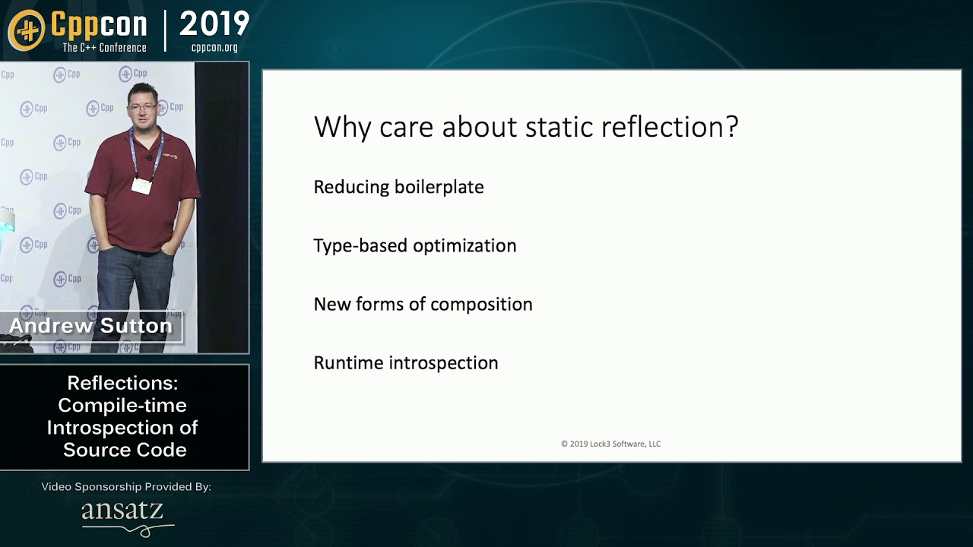
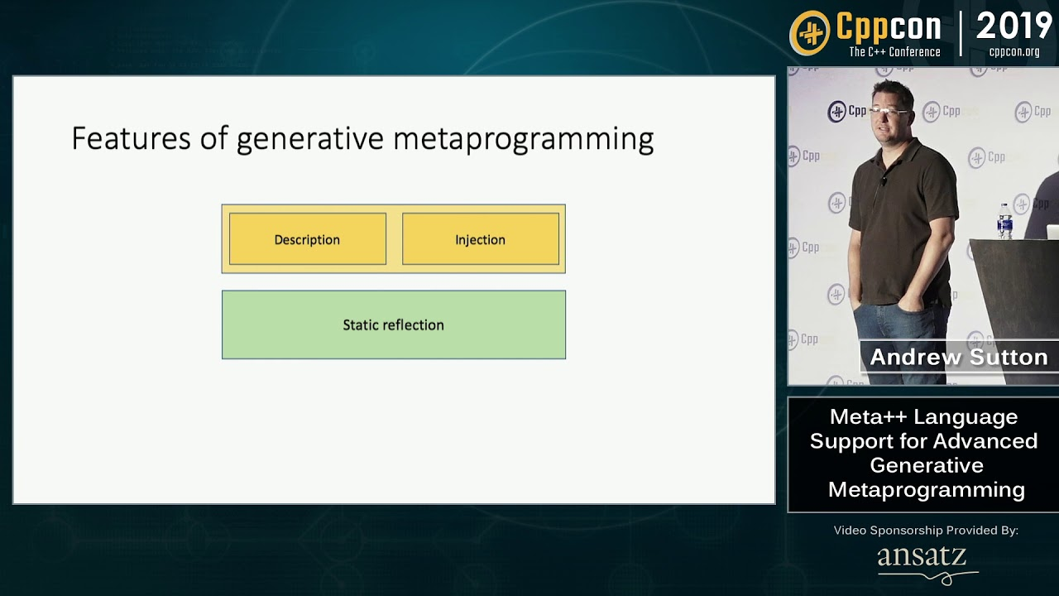

https://cppx.godbolt.org/
Proposal in the C++ standard P1717: https://wg21.link/p1717
https://youtu.be/ARxj3dfF_h0
https://youtu.be/kjQXhuPX-Ac

Slide 65

Metaprogramming is coming… kinda…
Pavel Novikov
@cpp_ape
Align Technology R&D
Thanks to Wyatt Childers for feedback!
Slides: https://git.io/JJ3dJ
@GameOfThrones

Slide 66

Bonus slides

Slide 67
Metaclasses
consteval void AddTextMember(meta::info type) {
for (auto m : meta::member_range(type))
->m;
-> fragment struct {
std::string text;
};
}
struct(AddTextMember) AddedMember {};
struct AddedMember {
std::string text;
};

Slide 68
Metaclasses
consteval void Interface(meta::info type) {
bool needDtor = true;
for (auto m : meta::member_range(type)) {
if (meta::is_data_member(m))
meta::compiler.error("an interface can not contain data members");
if (meta::is_destructor(m)) {
needDtor = false;
meta::make_virtual(m);
}
else if (meta::is_nonstatic_member_function(m) && !meta::is_defined(m)) {
meta::make_pure_virtual(m);
}
-> m;
}
if (needDtor) {
-> fragment struct T {
virtual ~T() = default;
};
}
}

Slide 69
Metaclasses
struct(Interface) Cat {
void meow();
void purr();
};
struct Cat {
virtual ~Cat() = default;
virtual void meow() = 0;
virtual void purr() = 0;
};

Slide 70
Metaprogramming as of December 2019

Slide 71
Metaprogramming
injection
fragments
metaprograms

Slide 72
Injection
consteval -> ...

Slide 73
Injection
namespace a {
int value = 42;
}
namespace b {
consteval -> reflexpr(a::value);
}
int value = 42

Slide 74
Fragments
const auto fragment = __fragment {};
consteval -> fragment;
consteval -> __fragment {};

Slide 75
Fragments
consteval -> __fragment {
std::string value = "injected variable";
};

Slide 76
Fragments
namespace fragment
class fragment (used for metaclasses)
enum fragment

Slide 77
Metaprograms
void foo() {
consteval {
-> __fragment {
std::string value = "injected variable";
};
}
use(value);
}

Slide 78
Metaprograms
consteval void immediateFunction() {
-> __fragment {
std::string value = "injected variable";
};
}
void foo() {
consteval { immediateFunction(); }
use(value);
}

Slide 79
More metaprogramming
template<typename Enum>
std::string toString(Enum value) {
consteval {
for (auto i : meta::members_of(reflexpr(Enum))
-> __fragment {
if (value == valueof(i))
return meta::name_of(i);
};
}
return "<unknown>";
}

Slide 80
Assembling it all together
template<typename Visitor, typename T>
void iterateMembers(Visitor &&visit, T &&value) {
consteval {
auto type = reflexpr(std::decay_t<T>);
for (auto m : meta::data_member_range(type)) {
-> __fragment {
visit(value.unqualid(meta::name_of(m)), meta::name_of(m));
};
}
}
}

Slide 81
Assembling it all together
template<typename Visitor, typename T>
void iterateMembers(Visitor &&visit, T &&value) {
consteval {
auto type = reflexpr(std::decay_t<T>);
for (auto m : meta::data_member_range(type)) {
-> __fragment { { // workaround
auto ptr = valueof(m);
visit(value.*ptr, meta::name_of(m));
} };
}
}
}

